Slide 1


Software Development Project-I
ECE 2100
Application:
My Store
Name: Promit Biswas
Roll:1810039, ECE’18

Slide 2

Contents
Project Objective
Software Requirements
Programming Language and Software's
Diagram (Layout Overview)
Layout Configuration

Slide 3

Project Objective
My store is mainly a android application which can perform different things. This application can store different product name, its price and its quantity. The user can update the features daily, can delete that product, can update the quantity of that product. This application will help the people who has the difficulty of storing many products and forget how many products are left.

Slide 4
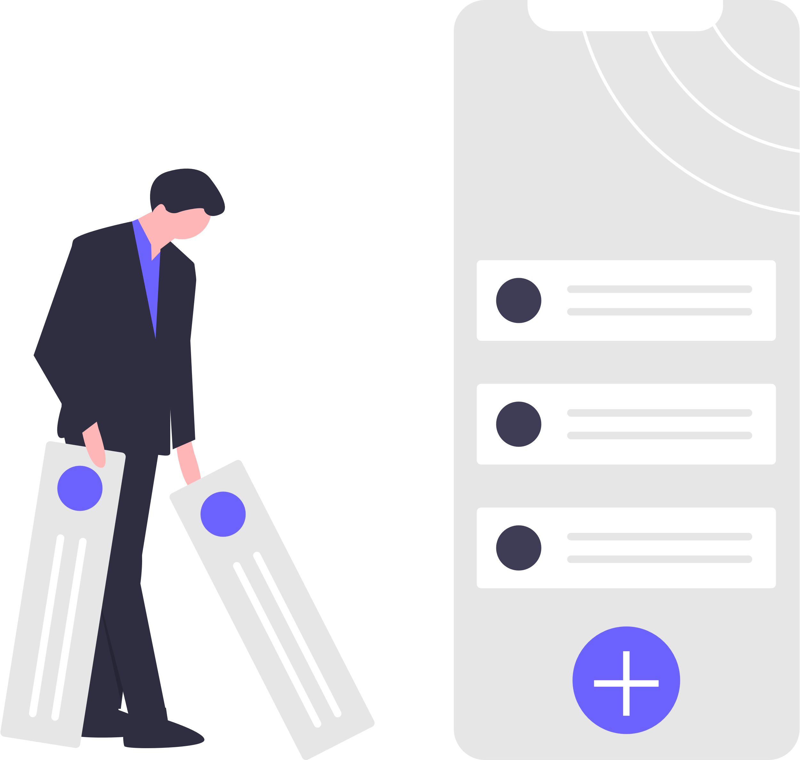
Software Requirements
Android version
Android OS version 4.0 and Higher version.
Permissions:
No Permission is needed
Minimum Space
10Mega Byte of Free Space

Slide 5
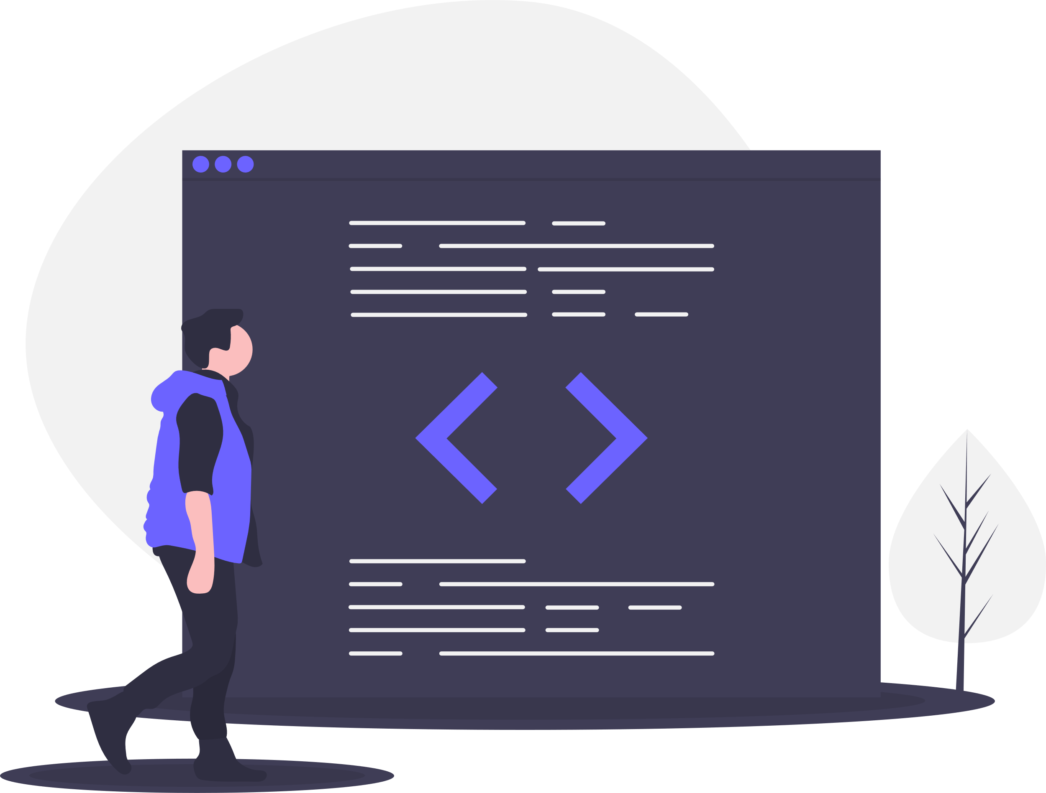
Programming Language & Software
Programming Language
Java For Android
MySQL For Database
Software
Android Studio

Slide 6
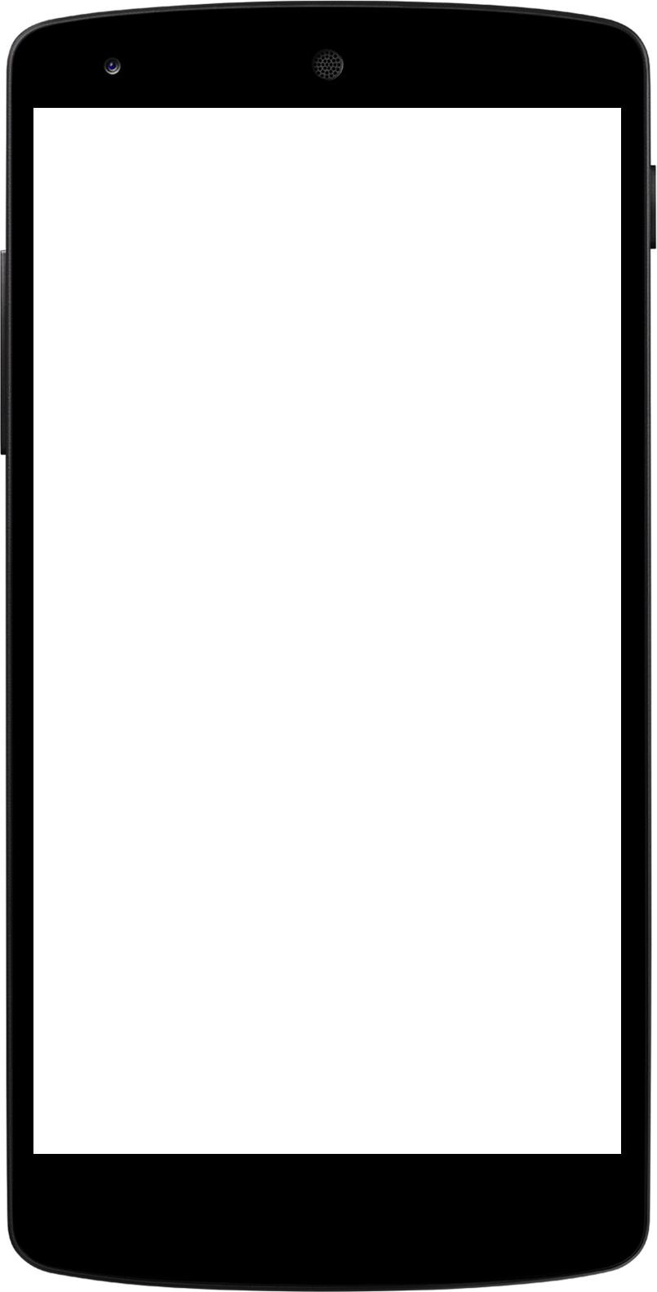
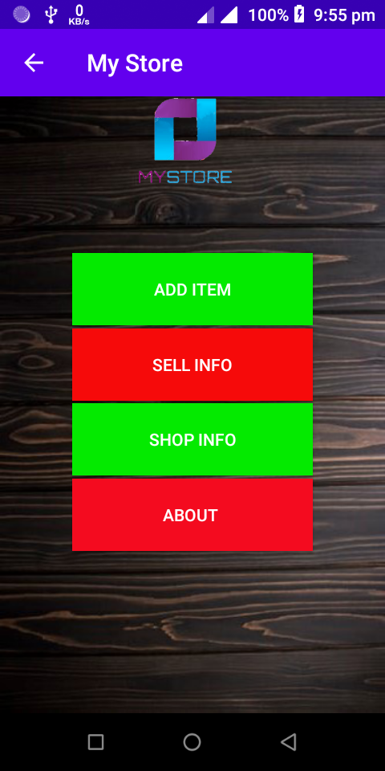
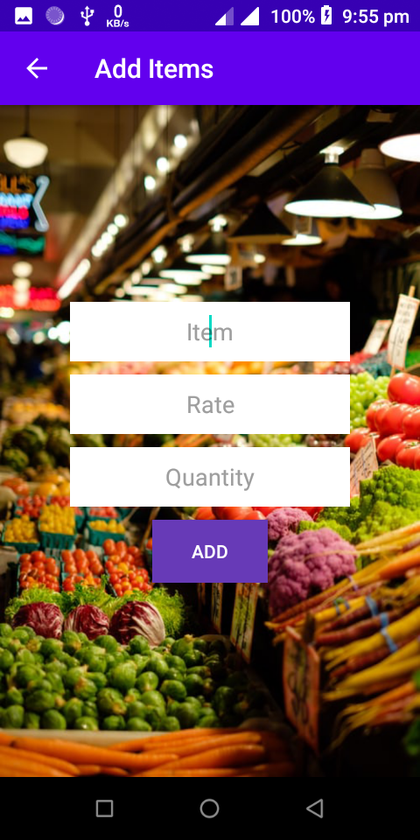
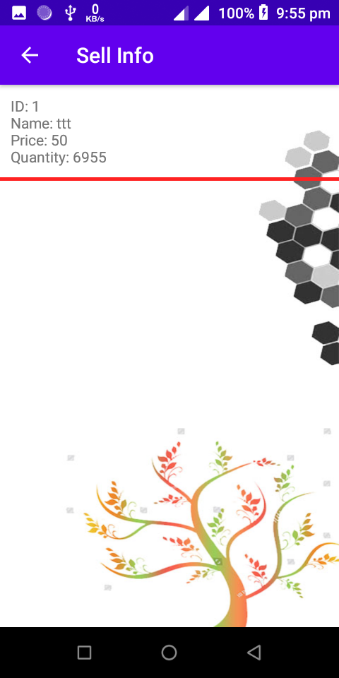
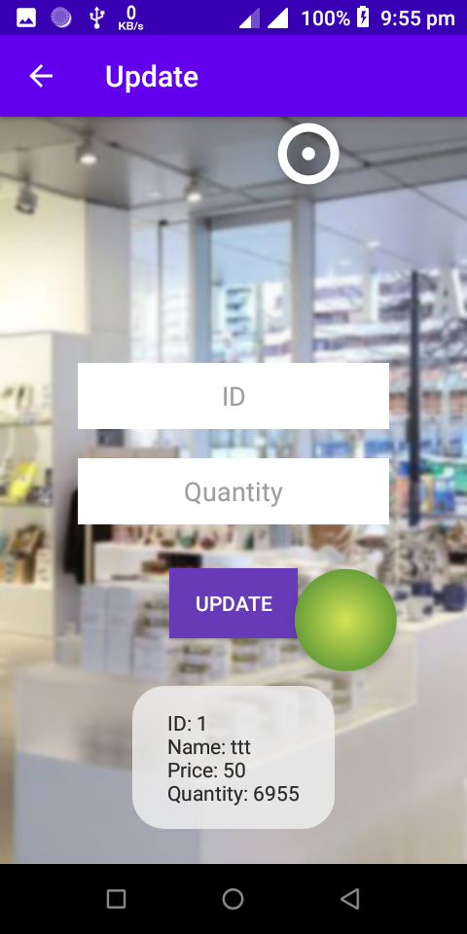
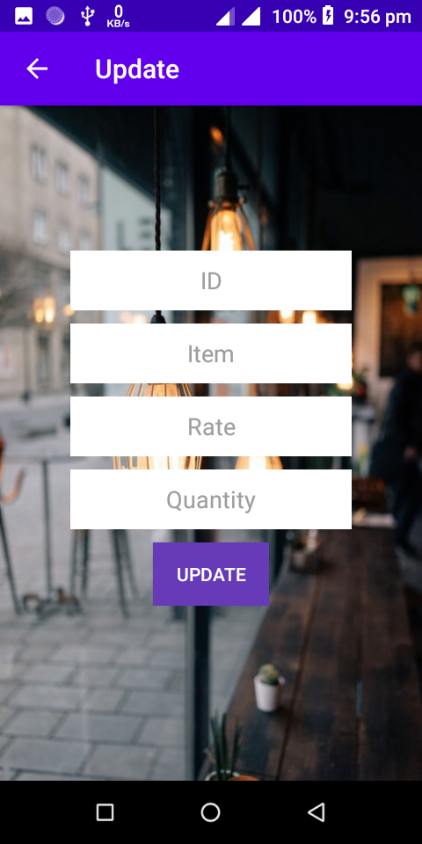
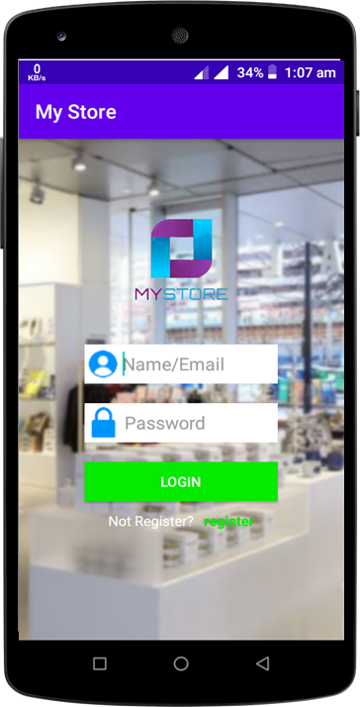
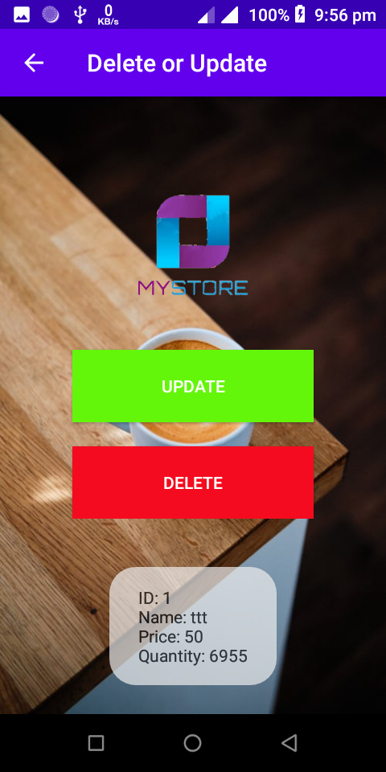
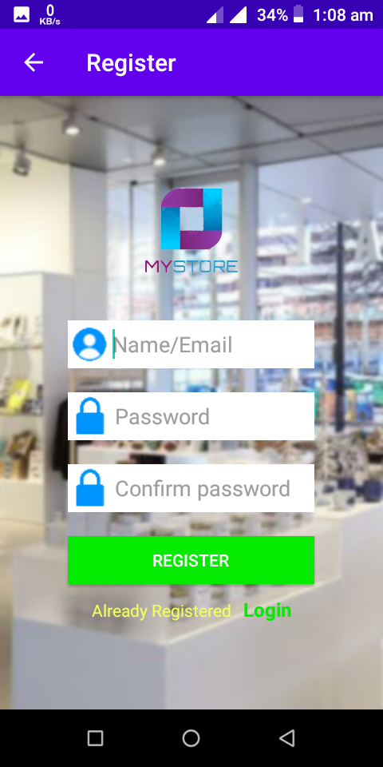

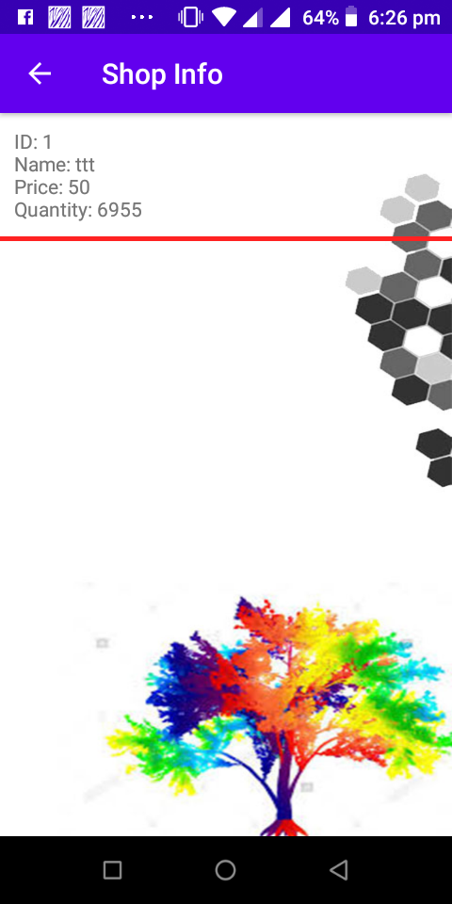
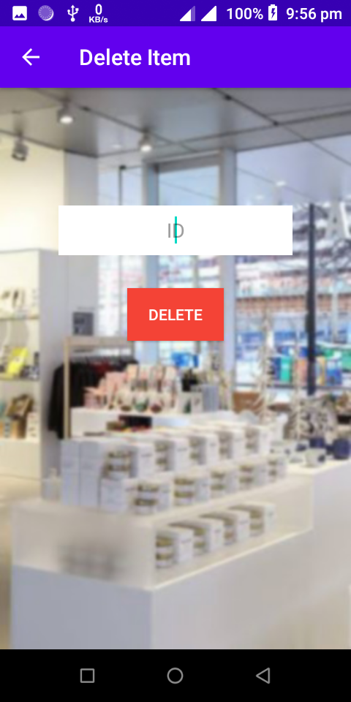
Diagram (Layout Overview)
Update Everything
Adding Items
Sell Info
Update Quantity
Login
Delete Or Update
Register
About
Shop Info
Delete

Slide 7
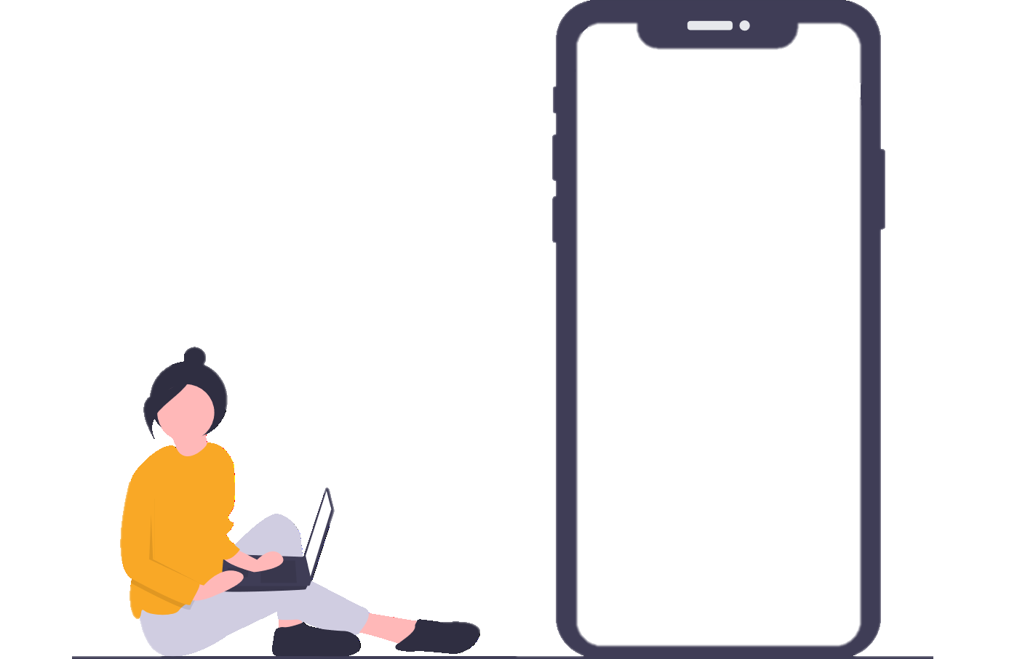
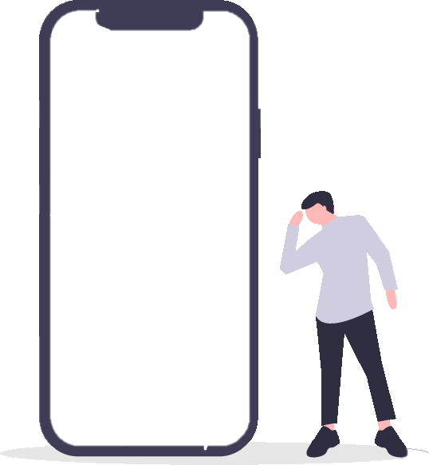
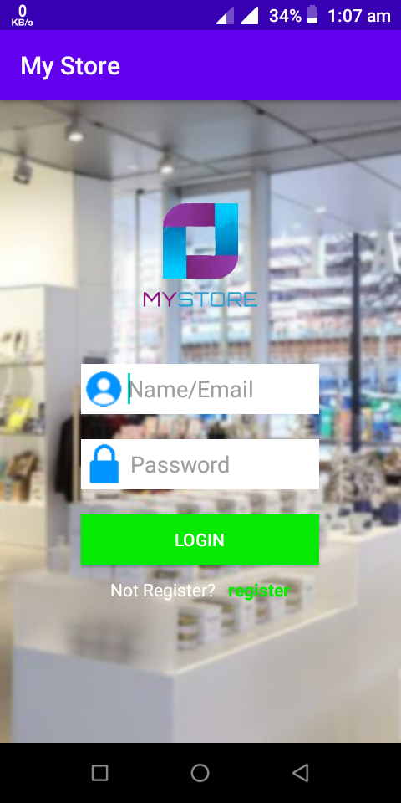

Layout Configuration
Login:
It is mainly a login Page. After Successful registration, we can enter the next page. Here SharedPreference system is used to access next page. If name and password are right then pressing login button this layout will intent Home page.
Registration:
It is mainly a layout to resister name and password. Password needs minimum 4 character and password should be confirmed as before is inserted. If resister button is pressed and before criteria is fulfilled then the layout will changed to Login page.

Slide 8
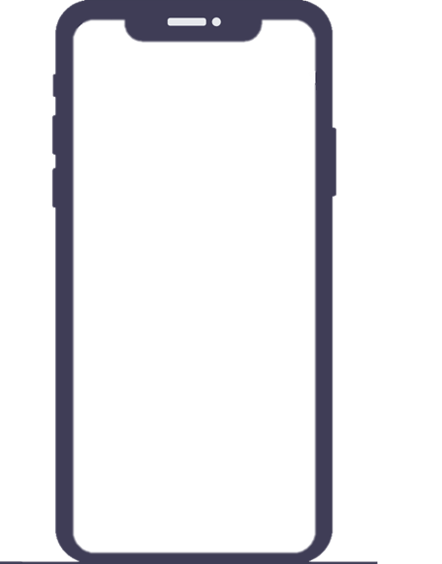
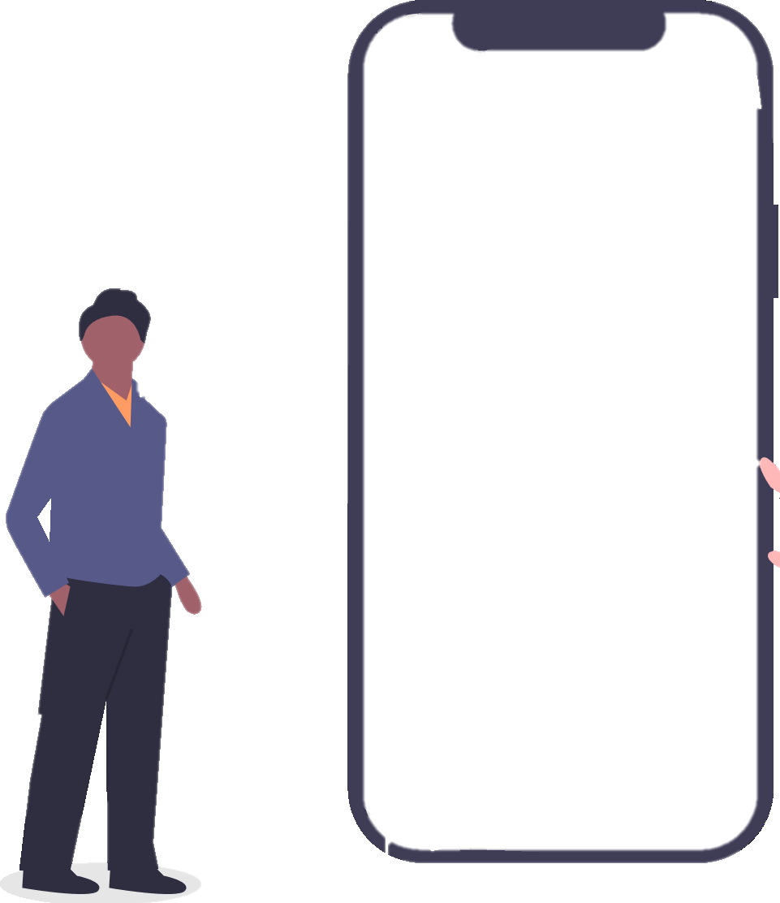

Layout Configuration
Home Page:
After Successful Login, user will come to this layout. Here four button has to perform different works.
Add Items:
It is layout of adding a store has products. Here MySQL database is used to access all of those. Here user can add Item name, rate of the product and how much products available in user’s store

Slide 9
Layout Configuration
Sell /Shop Info:
Here two layout has same property, here how many products, price and quantity will be shown. A ID will be given to delete and update those value in sell info and shop info layout
Update:
Update is accessed from shop info to update everything of an element.

Slide 10
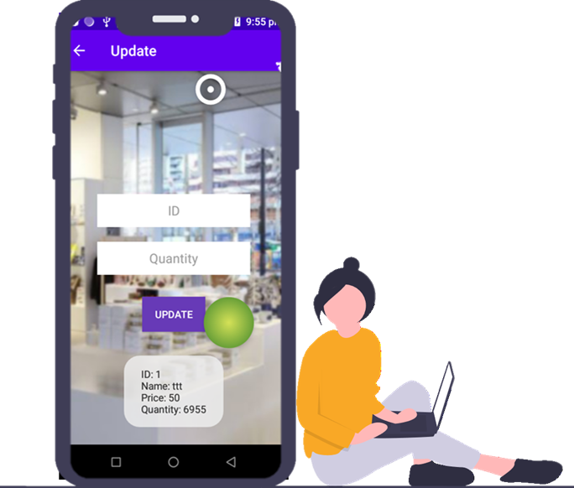
Layout Configuration
About:
This is a layout for knowing about Developer of this Application.
Update:
Update is accessed from sell info to update quantity of an element.

Slide 11
Layout Configuration
Delete or Update:
Delete or Update is accessed from shop info to do two different tasks. One button is for update all elements and delete button is applied for deleting the items.
Delete:
Delete layout is accessed from the layout Delete or Update. delete is applied for deleting the items the user has already inserted.

Slide 12


THANK YOU!
Any Question?

